Slide 1
UNC Data Bootcamp August 2019 Cohort
Air Quality and Why We Care
Team 3
Ahnaf
Alex
Nadire
Nishi
Shi

Slide 2
Air Quality and Why We Care
The World Health Organization (WHO) states that over 80% of urban residents are exposed to air pollution levels that exceed WHO limits.
Data for this project was collected through the IQ Air AirVisual API
The goal of the AirVisual API is to make air quality data more accessible to the general population.
With a greater awareness of local air quality, people will be more empowered to make a difference in their environment.

Slide 3
Aim of this Project
Do the selected weather parameters (Temperature, Pressure, Humidity, and Wind Speed) impact the air quality index
We explore variations of this question
Across North Carolina
Cities across the US
Cities in Hubei, China
Selected international cities with large populations

Slide 4
Air Quality Analysis for North Carolina

Slide 5
Air Quality for North Carolina
Air Quality Index is used for reporting daily air quality. It tells you how healthy your air is. This part of the project makes analysis for North Carolina cities.
The questions are:
. What is the air quality in North Carolina?
. What are the main air pollutants for NC?
. Is there any relation between weather and air quality? Such as high temperature, air pressure, humidity and air quality?

Slide 6
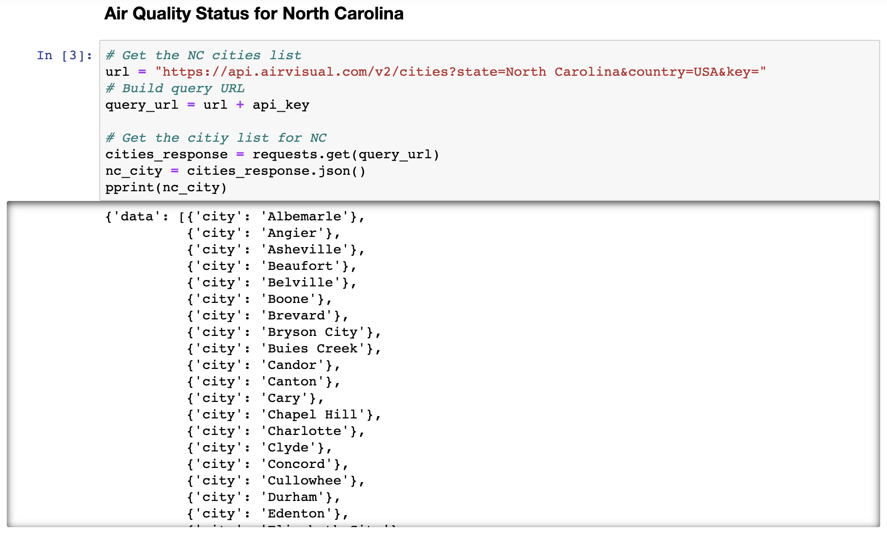
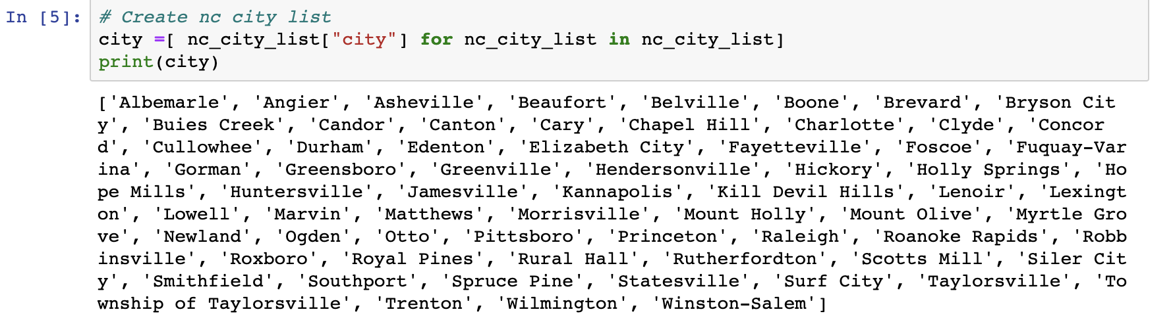
Getting the data from AirVisual
First part was to get cities list for NC from AirVisual with the API key, and json requests. Response was the cities name dictionary with a list of dictionaries as values for 67 cities in North Carolina. Using the list comprehension we got the cities list.

Slide 7
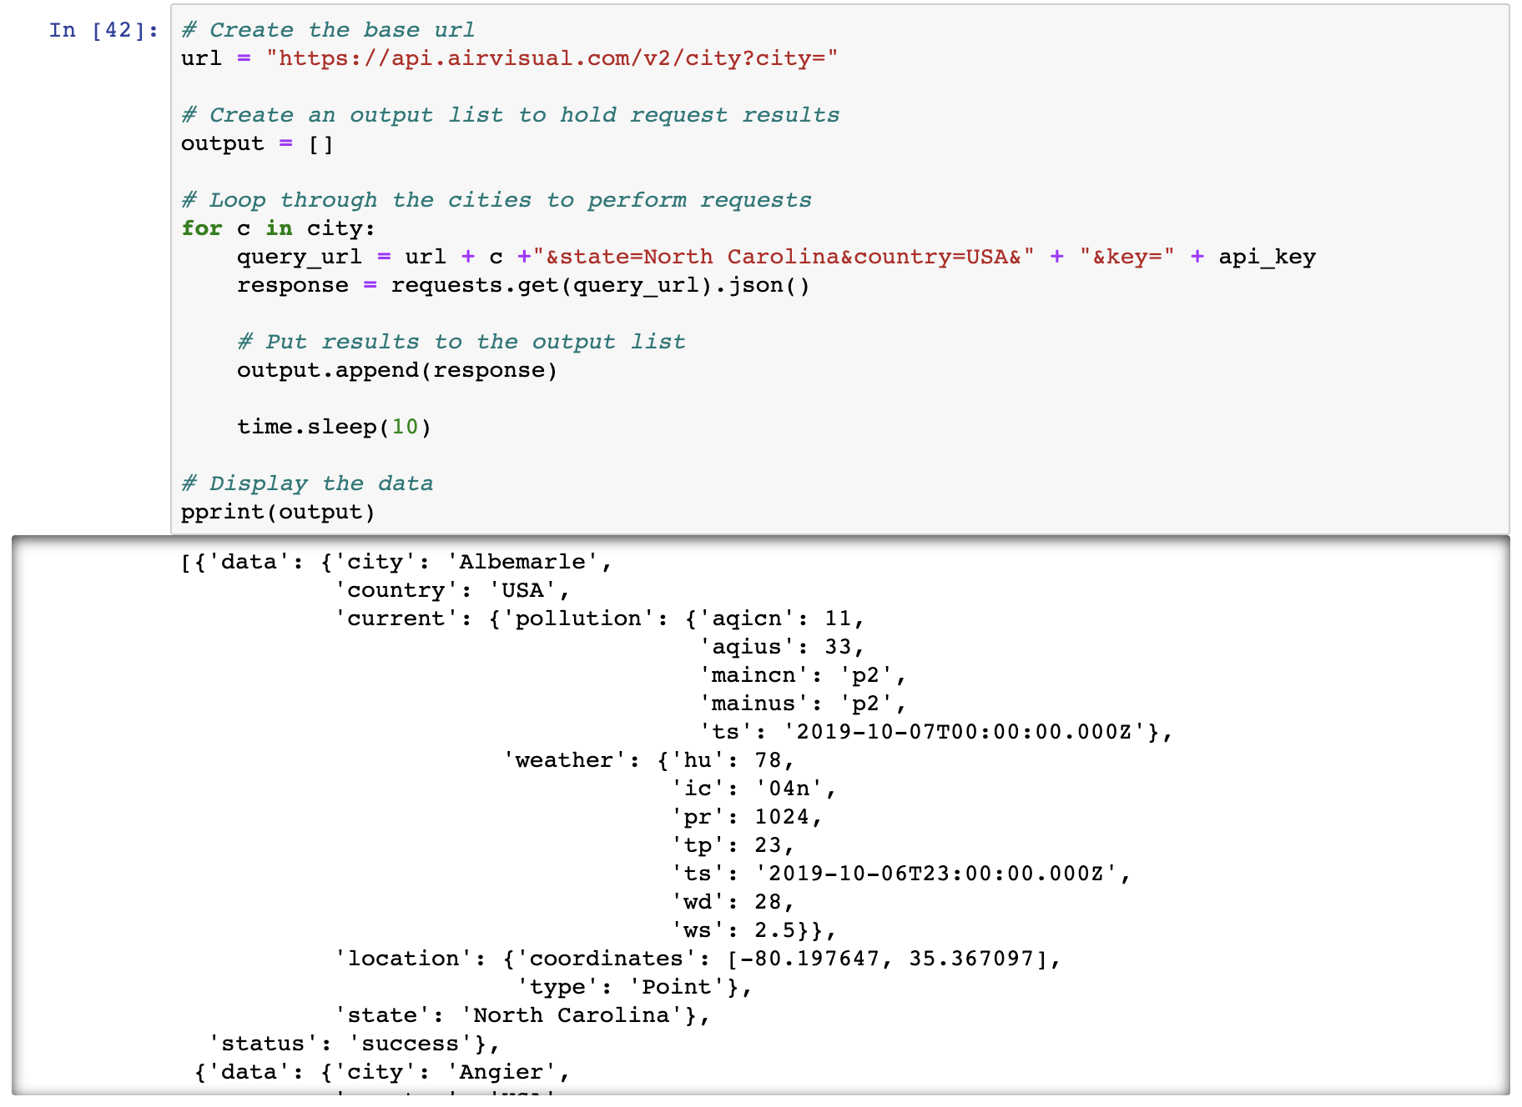
Getting the data from AirVisual
After getting the city list, we used for loop to create a new query url and to run json requests to get response for each cities information.
Response was a list of dictionaries that hold information for each cities.

Slide 8
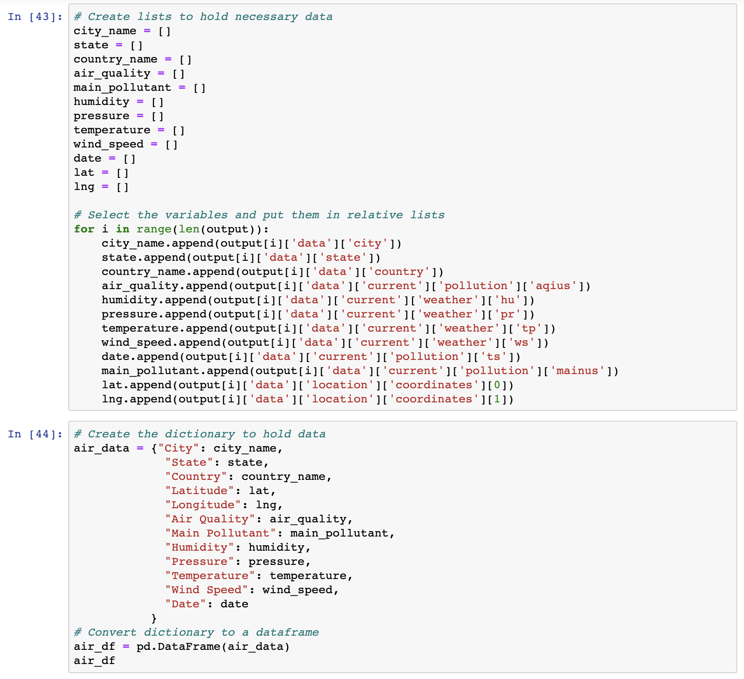
Selecting the Data, and Creating the Data Frame
After getting the response for each city, the aim was to select the necessary data such as air quality index, temperature, air pressure, humidity, main pollutants, date, from the response to create the data frame to organize the data.

Slide 9
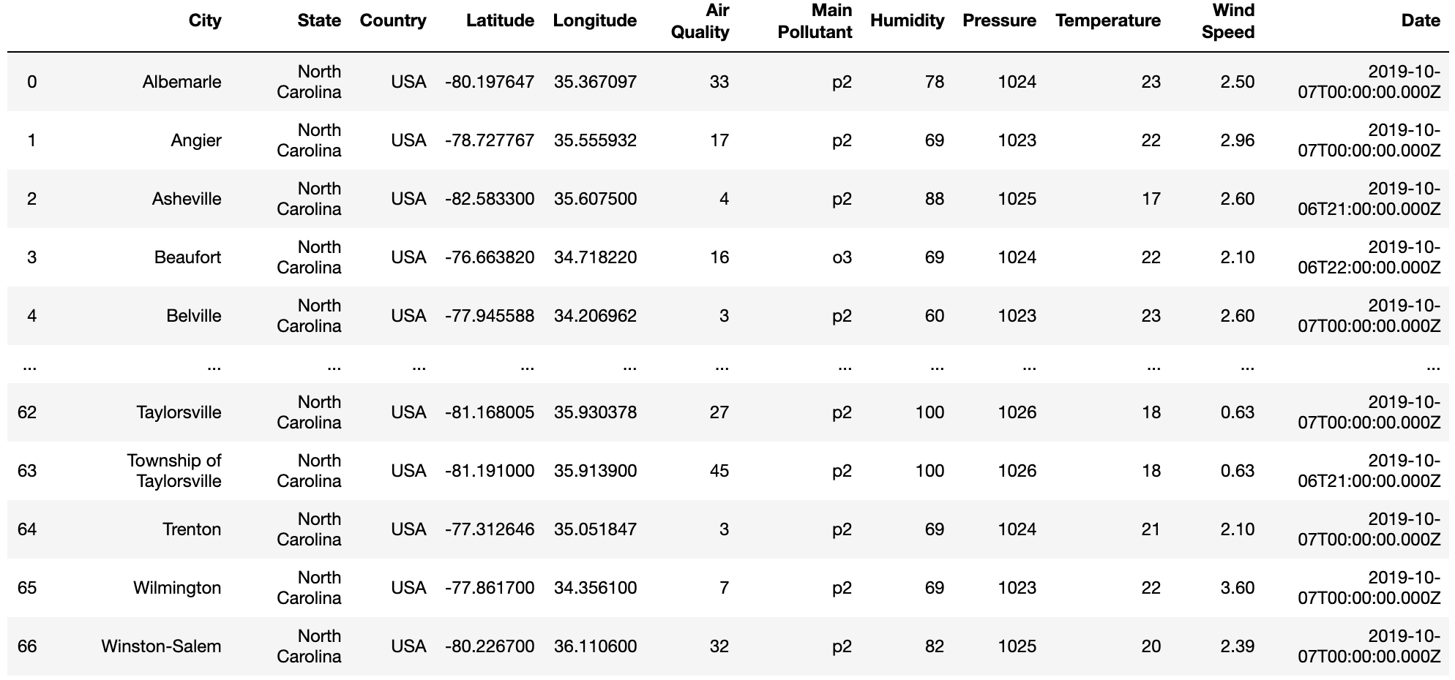
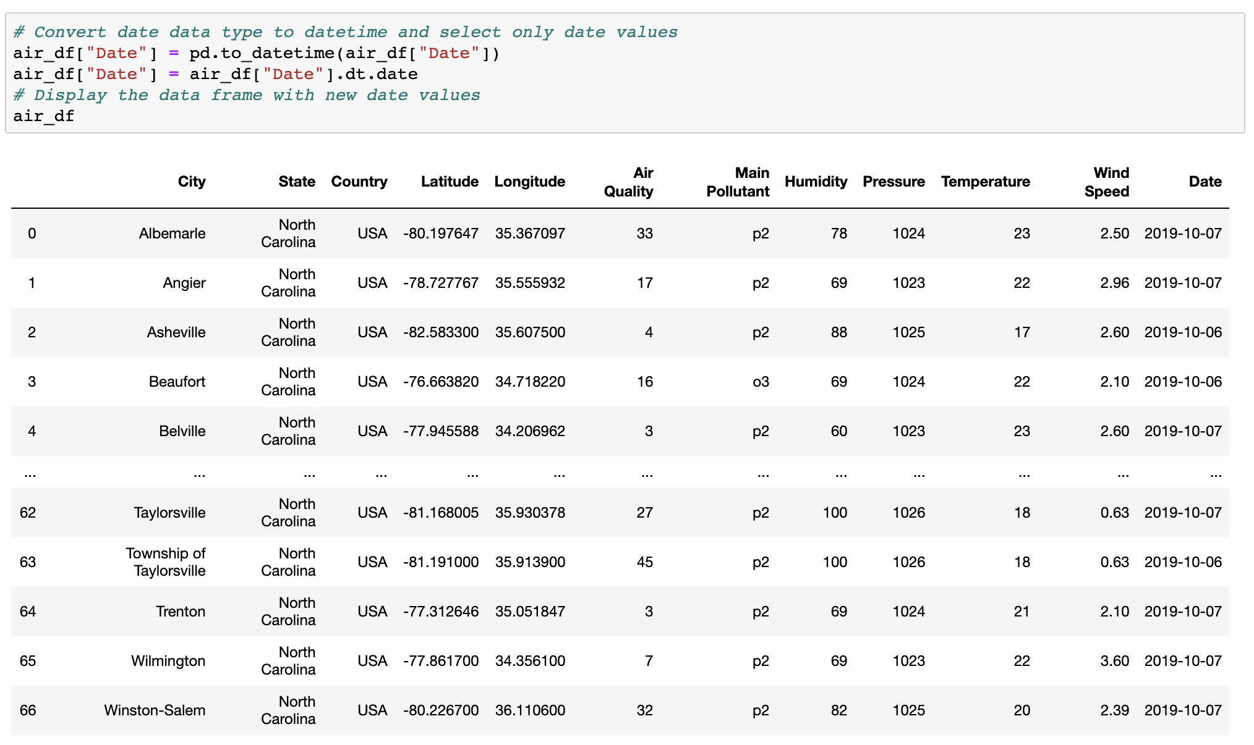
Data Frame and Cleaning the Data
AirVisual stores date values as timestamps, so to get only the date part we needed to do some cleaning for the date values. First step was converting data type from object to datetime.
After the conversion dt.date function gets the date part only, for the data frame.

Slide 10
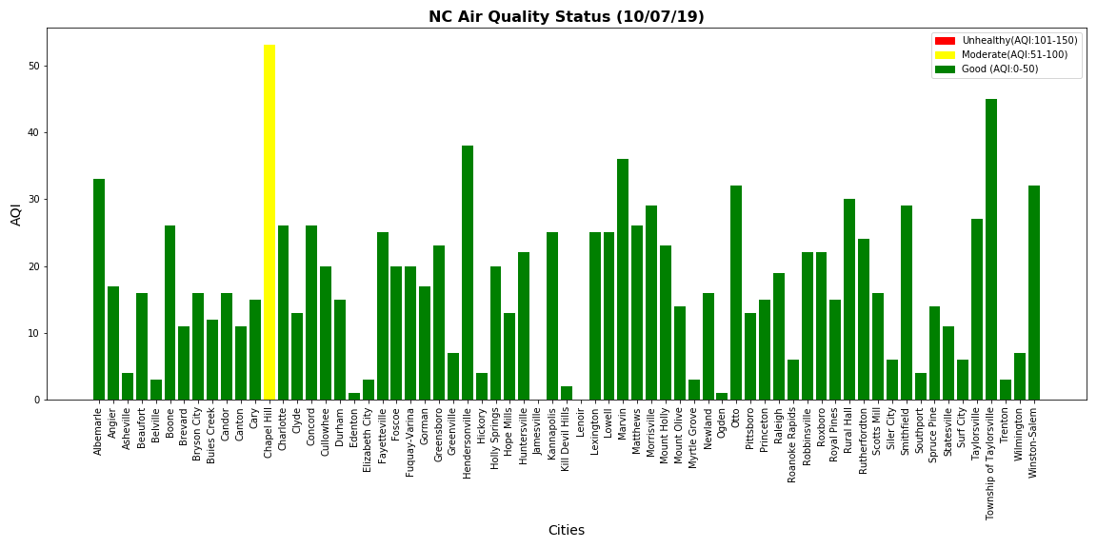
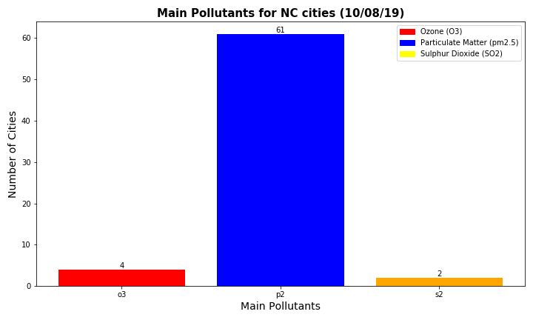
Creating the Plots:
EPA(Environmental Protection Agency) AQI Standards:
AQI: 0-50 Good
AQI: 51-100 Moderate
AQI: 101-150 Unhealthy for Sensitive Groups
AQI: 151-200 Unhealthy
AQI: 201-300 Very Unhealthy
AQI: 301-500 Hazardous
NC Air Quality plot shows that North Carolina cities have healthy AQI in general. Most cities AQI is under 50.
Common air pollutants are: Ozone(O3), Particulate Matter(P2, P1), Nitrogen dioxide(NO2), Sulphur dioxide(SO2),Carbon monoxide(CO)
Main Pollutants plot shows the pollutant types for NC and we can say most cities have p2(Particulate Matter) as main pollutant.

Slide 11
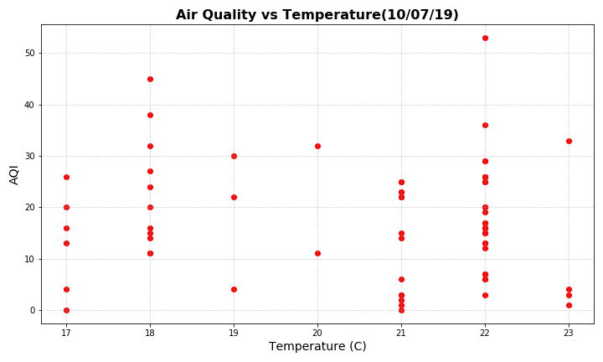
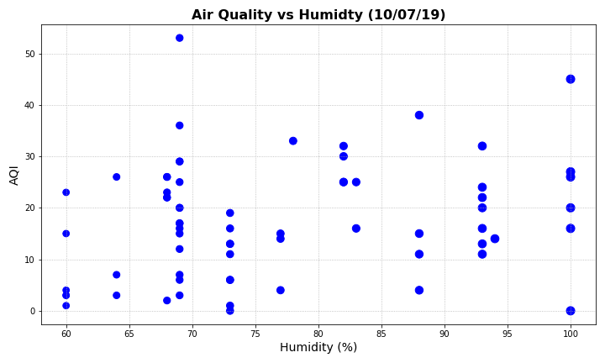
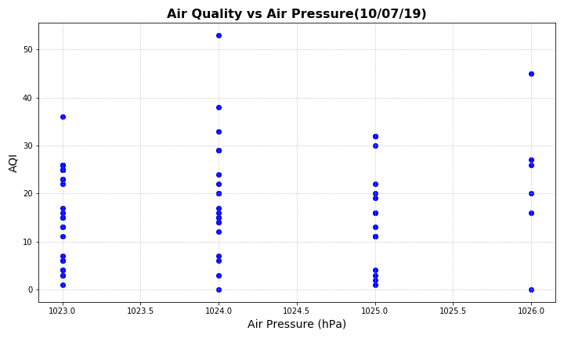
Weather and AQI Relation for NC
Using the relative data from the data frame, we created scatter plots to show any relations between temperature and air quality, humidity and aqi and air pressure and aqi.
As a result we can say for the specific day there is no relation between these parameters.

Slide 12
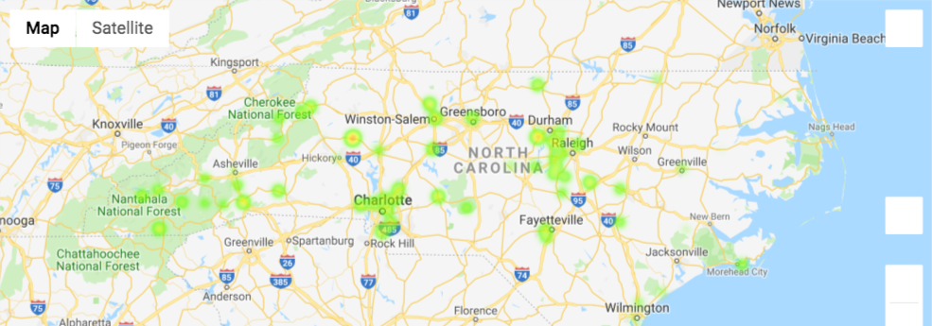
NC Heat Maps: Air Quality
Across the state air quality is in the good range (0-50)
Some cities found to be in the moderate range (50-100): Raleigh, Charlotte, Durham, and Chapel Hill
We did not find any significant difference in AQI for coastal areas vs mountains.

Slide 13
Air Quality Analysis for Major US Cities

Slide 14
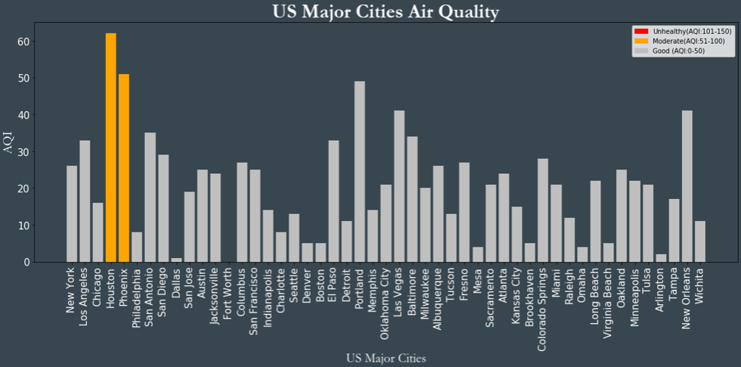
Major Cities in the US
EPA(Environmental Protection Agency) AQI Standards:
AQI: 0-50 Good
AQI: 51-100 Moderate
Most major cities in the US have a AQI score of less than 50
Only 2 cross the threshold - Houston, TX and Phoenix, AZ

Slide 15
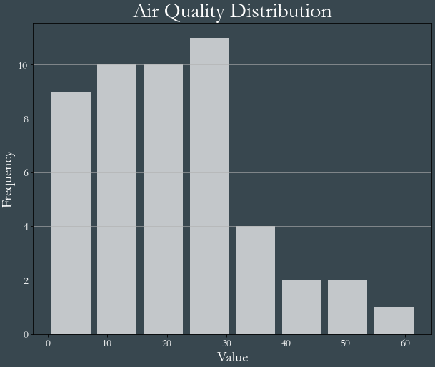
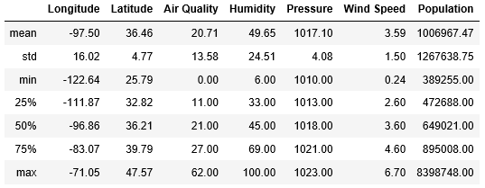
Data Summary Statistics
Air Quality - We are assessing air quality as our primary dependent variable. The distribution of Air Quality among the top cities is very even up to an index to 30 after which it follows an negative exponential pattern. Air Quality distribution has a mean of 20.71, median of 21.00, and a standard deviation of 13.58

Slide 16
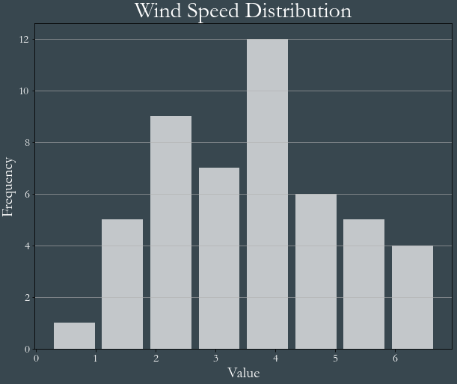
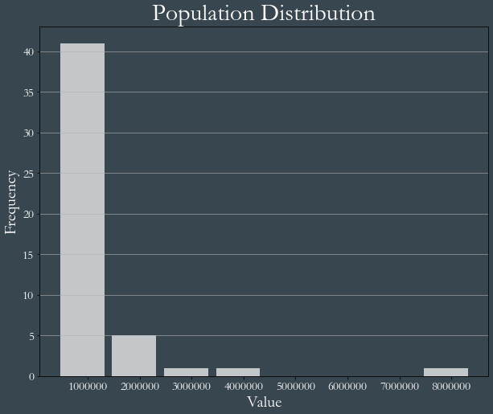
Distribution of variables
Wind Speed - The variation of Wind Speed very closely follows a normal distribution with a mean of 3.59, median of 3.60, and standard deviation of 1.50.
Population - The variation of Population follows a negative exponential curve with a mean of 1m, median of 0.6m, and standard deviation of 1.3m

Slide 17
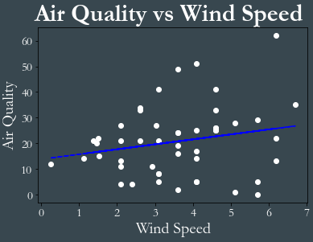
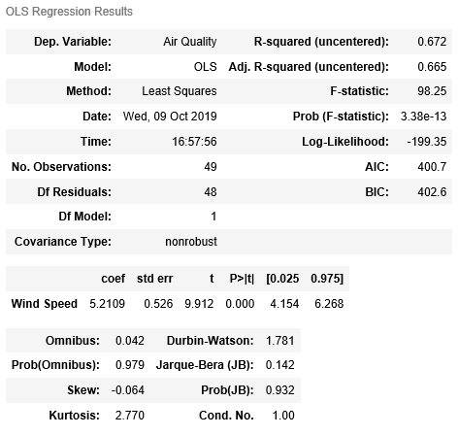
Regression Models - Air Quality vs Wind Speed
The result suggests that even 1 unit increase in Wind Speed has 5.2 unit increase in Air Quality Index with a p-value of 0.000
Based on the R square, the model explain only 67% of the variability in the relationship

Slide 18
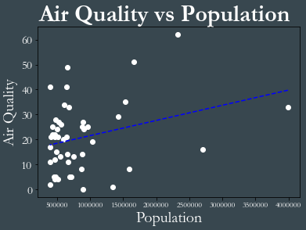
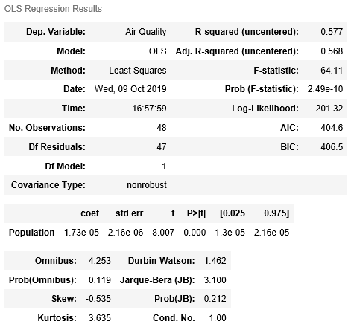
Regression Models - Air Quality vs Population
The result suggests that even 1 unit increase in Population as 1.73^-5 unit increase in Air Quality Index with a p-value of 0.000
Based on the R square, the model explain only 58% of the variability in the relationship

Slide 19
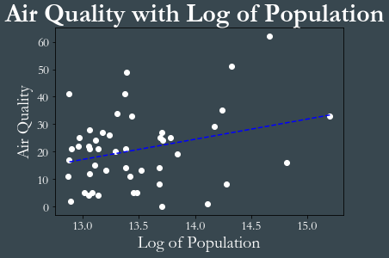
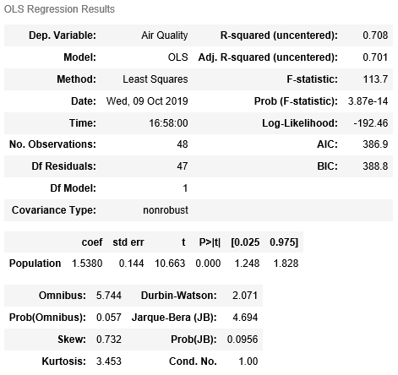
Regression Models - Air Quality vs Log of Population
The result suggests that even 1 unit increase in Log of Population as 1.5 unit increase in Air Quality Index with a p-value of 0.000
Based on the R square, the model explain only 71% of the variability in the relationship

Slide 20
Air Quality Analysis in China

Slide 21
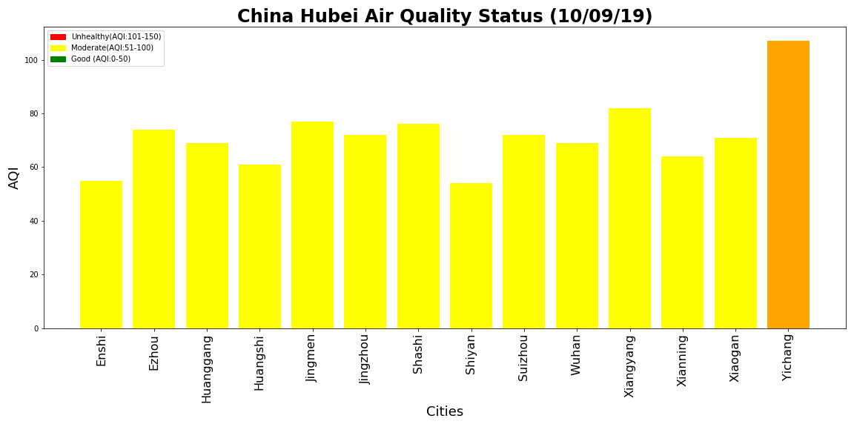
Air Quality Index (AQI) for Cities in Hubei, China
-Based on AQI data for 2019-10-09

Slide 22
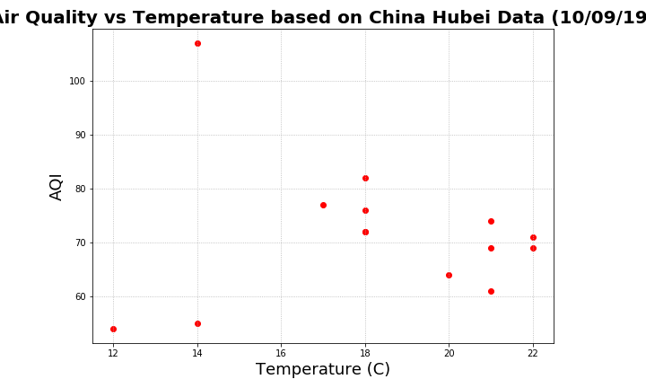
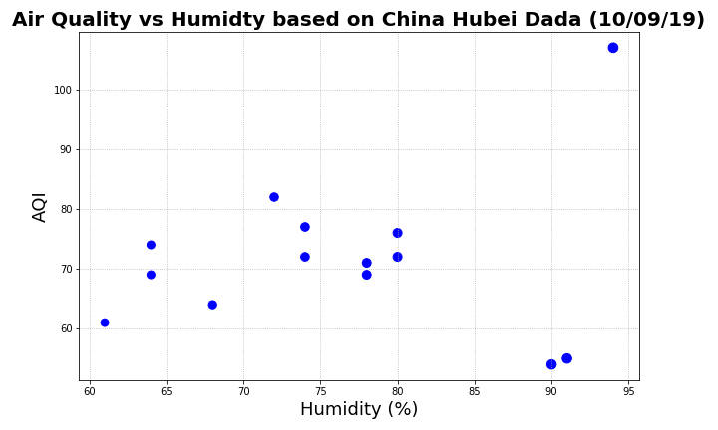
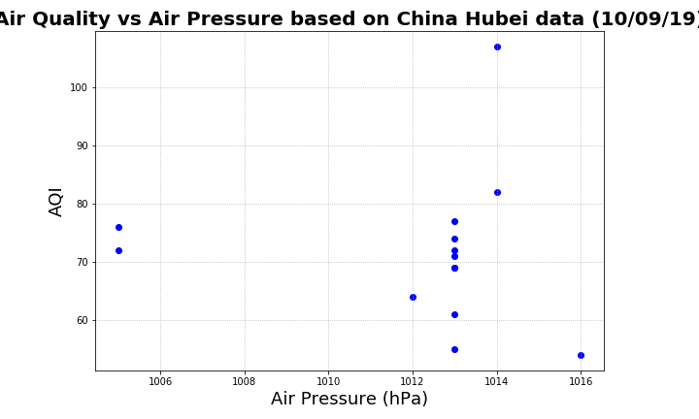
Weather and AQI Relation for Hubei, China
Using the relative data from the data frame, we created scatter plots to show any relations between temperature and air quality, humidity and aqi and air pressure and aqi.
As a result we can say for the specific day there is no relation between these parameters.

Slide 23
Air Quality Analysis Global

Slide 24
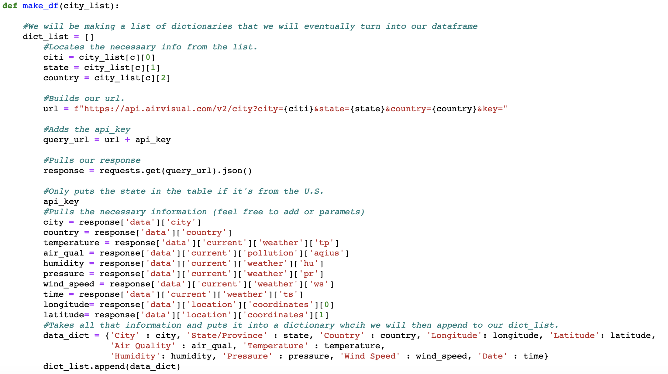
Creating an API Call Function for Cities Around the World
Trying to make a complicated code easy to use repeatedly.

Slide 25
Importing the function into different sheets
Example of the function in use:

Slide 26
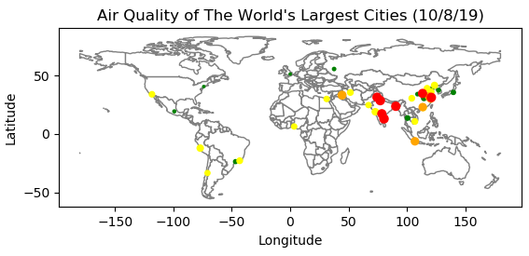
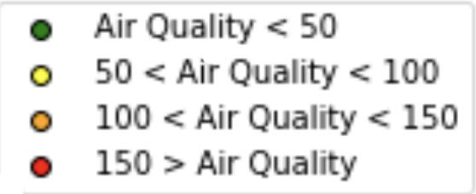
Notes:
You can see that 1) Most of the world’s largest cities are in Asia.
2) Air Quality in the big cities in India/Pakistan/Bangladesh is worse than other parts around the world.
3) If we could do this again, we’d add more cities around the world so it would be easier to compare.

Slide 27
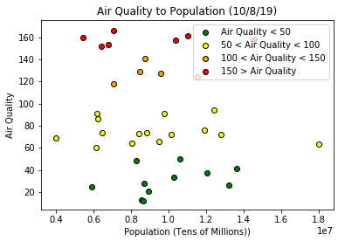
Is there a relationship between Air Quality and Population?
•Not really amongst the world’s largest cities.
•Further study: Examining the relationship between population density and air quality.
Notes:
Amongst the biggest cities, there doesn’t seem to be much of a relationship between population and air quality.
Ahnaf mentioned exploring population density (ex: Dhaka Bangladesh had the worst air quality in our dataset, but it’s also the second densest city in the world).

Slide 28
Limitations to our project
1. Our AirVisual API only allows a certain number of API calls per minute.
2. Each API call requires us to input the “state” of a city, which is tedious to find for international cities.
3. AirVisual didn’t have any historical data for our search so we had to use current data only.

Slide 29
Conclusions
1. Air Quality appears to be more closely related to what area of the world you live in, not the size of your city.
2. Most cities across North Carolina and the US have good to moderate air quality while many cities in China, India, Bangladesh, and Pakistan have unhealthy air quality.
3. Further research: Studying the relationship of Air Quality to Population Density.

